Slide 1
OSWEGO COUNTY
EDUCATORS
Together we make
students future ready

Slide 2

Special Thank you
(no particular order)
• CiTi PROGRAM STUDENTS, PARENTS, STAFF:
Culinary, Public Safety, Digital Media,
Agriculture, Advantage, Work Study, and
Project Explore
• GUEST CHEFS: Sue Jerrett & William Steele
• Previous Culinary Arts Students
• STUDENT PERFORMERS: Pulaski CSD
• CiTi STAFF FROM: O&M, Technology,
Public Relations, and Print Shop
• Annual Meeting Planning Committee
• Marla Berlin, Carolyn Deary-Petrocci,
Missy Allard, and Amy Rhinehart
• CiTi Board Members
• SCHOOL DISTRICTS: Board Members,
Superintendents, Administrators and
Staff

Slide 3

CiTi BOCES
2025-26 Draft ADMIN. BUDGET
ANNUAL MEETING; April 2, 2025
➔ General Fund Budget
➔ Administrative Budget
➔ Board Candidates
➔ Vote Date
➔ Questions/Discussion

Slide 4

DRAFT total GENERAL FUND BUDGET
COSER | 2024-25 adopted Budget | 2025-26 Tentative Budget | $$ Difference | % Difference
Administrative | 8,986,399 | 9,355,325 | +368,926 | 4.11%
Program | 69,637,108 | 77,251,049 | +7,613,941 | 10.93%
Capital | 1,788,851 | 1,849,690 | +60,839 | 3.40%
Total | $80,412,358 | $88,456,064 | +$8,043,706 | 10.0%

Slide 5
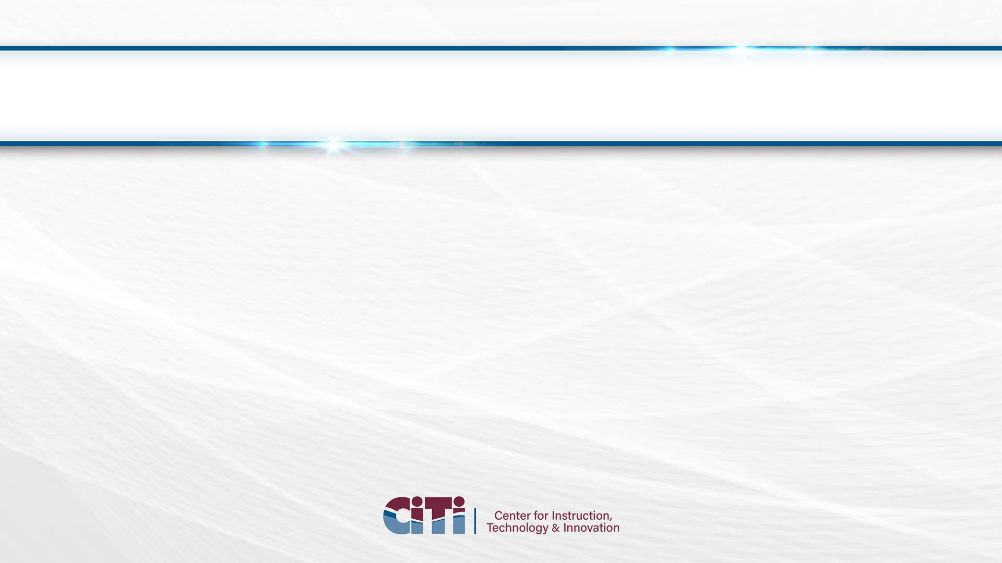
DRAFT TOTAL GENERAL FUND BUDGET

Slide 6
What’s in the Admin. Budget?
“central office” including:
Board of Education
District Superintendent’s Office
Human Resources Office
Administrative Services Office
Business Office
Debt (if applic.) – Rev. Anticip. Note (RAN)
Retiree Health Ins. Costs (from all dep’ts)
Share of Internal Ops. (transfer charges)
Administrative CoSer 001 is 1 of 156 active General & Federal fund CoSers.
TOTAL STAFF = 14.26 FTE
[2.8 Adm.; 11.46 Coord./Support]
{.20 Adm. & 1.54 Coord./Support staff budgeted in other programs where job duties reside}

Slide 7
DRAFT ADMINISTRATIVE BUDGET
Item | 2024-25 ADOPTED | 2024-25 Adjusted | 2025-26 Proposed | Diff. w/ Adopted Budget | % of Prev. | % of Total
Salaries | 1,417,820 | 1,417,820 | 1,485,983 | + 68,163 | 4.8% | 18.5%
Equipment | 9,080 | 9,080 | 9,080 | - | - | -
Supplies | 28,520 | 28,520 | 30,150 | +,1,630 | 5.7% | 0.4%
Contractual | 591,265 | 620,344 | 608,104 | +,16,839 | 2.8% | 4.6%
Debt Svc. | 5,000 | 5,000 | 5,000 | - | - | -
Benefits | 618,280 | 618,280 | 637,395 | + 19,115 | 3.1% | 5.2%
Retiree Hlth. | 6,012,935 | 6,012,935 | 6,261,762 | +248,827 | 4.1% | 67.4%
X-Charges | 383,499 | 383,499 | 397,851 | + 14,352 | 3.7% | 3.9%
X-Credits | ($80,000) | ($80,000) | ($80,000) | - | - | -
TOTAL | $8,986,399 | $9,015,478 | $9,355,325 | + $368,926 | 4.11% | 100%

Slide 8
Budget Increases Separated
Total admin. Budget:
$368,926 or 4.11%
Retiree Health:
$248,827 or 2.77%
All other parts:
$120,099 or 1.34%

Slide 9
SELF-INSURED Health insURANCE Savings measures
2024 – Re-education & targeted reminders on CANARX. Stepped up efforts Rx
utilization mgmt., medical clinical optimization; reminders for Telehealth
2023 – Rx: Specialty Copay Assist, Mandatory Mail, Utilization Mgmt., Advantage
Formulary, Education/Information on CANARX, Prior Authorization for step-up
2022 – RFP for TPA – est. savings $400k/yr. Rx Clinical Optimization (start 1/1/22)
2021 – RFP for PBM (start 10/1/21), estimated savings approx. $400k - $500k/yr.
2020 – NEGOTIATIONS incr. premium share to 15% and 20% (13% for Support & TA’s)
TELEHEALTH saved approx. $30k annually so far. Could hit $100k+ in future
DISEASE MGMT. (5/1/20), could save $200k to $1m+, depending on particip.
2017 – CANARX (9/1/17 start) – Voluntary; Est. savings $50k/yr. ($800k/yr @ full use)
2014 – EGWP – (start 1/1/14) Federal subsidy program. Est. savings $1m+ annually
2013 – NEGOTIATIONS 3 tier Rx; eligibility up from 10 to 15 years; 80/20 coinsurance.
2012 – Changed PBM (medco to proact) est. saved $400k; subsequent contract restructure, saved $200k
FUTURE IDEAS UNDER REVIEW
PHARMACY (PROACT)
  Mandatory Generic Fill
  Dispense as Written
  (chg. diff DAW v. generic)
MEDICAL (UMR)
  Use of a Dental Network
  Utilization Management
  Comprehensive Health Wellness Program
OTHER (HAYLOR, FREYER & COON)
  Stop Loss Ins. - raising deductible, moving to national plan or eliminating coverage.
  Continued exploration of Medicare Advantage Plan

Slide 10



2025-26 Board Candidates
Allison Douglas
CENTRAL SQUARE CSD
(3-Year Term)
Nicole Nadeau
APW CSD
(3-Year Term)
Rob Southworth
PHOENIX CSD
(3-Year Term)

Slide 11
Questions?
Michael Sheperd
Assistant Superintendent
msheperd@citiboces.org

